Slide 1

Walk to School Week
Monday 18 May – Friday 22 May 2026

Slide 2

Why should we walk to school?
  Makes us more active
  Practice using the green cross code
  We chat to people walking with us
  Good for our mental health
  Reduces traffic outside school
  Reduces air pollution outside school

Slide 3
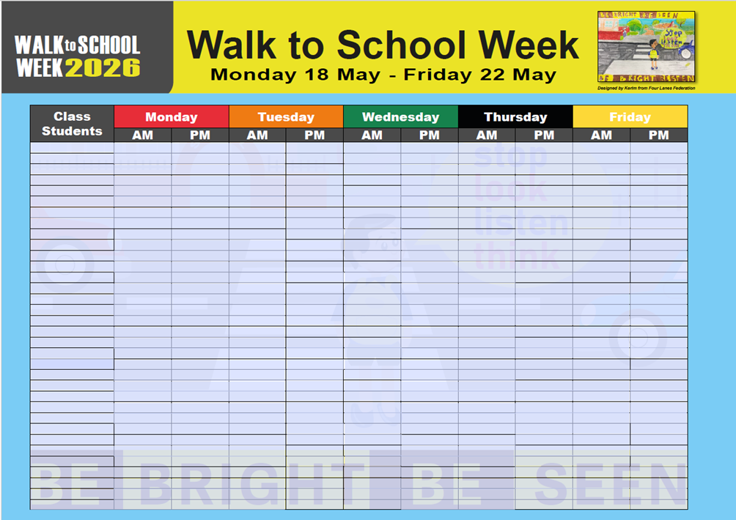
What do you need to do to take part?
Walk, cycle or scoot to school
Park and stride – park further away and walk the remainder of the journey.
Complete the class chart – ticking off who has travelled actively each day
At the end of the week, each child who has walked (or scooted or cycled) to school every day will receive a certificate

