Slide 1



Bringing up a child in the 21st century
Haselworth Primary School
Parent e-safety workshop

Slide 2











Slide 3
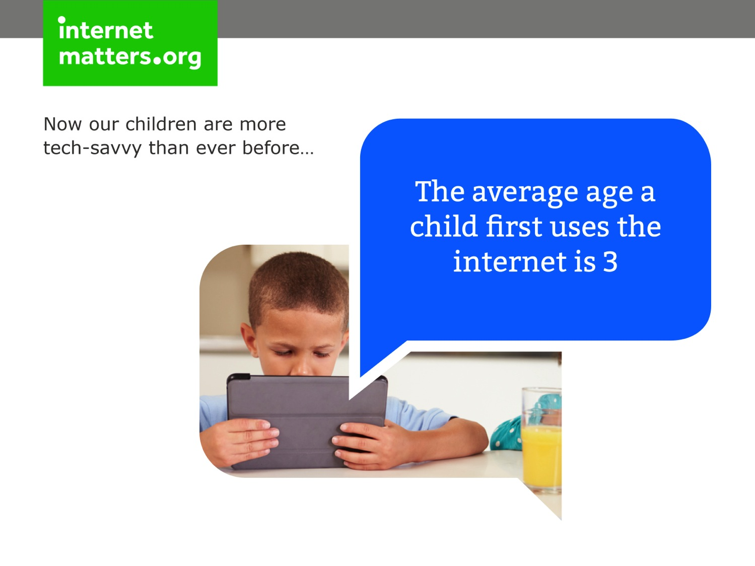

Slide 4
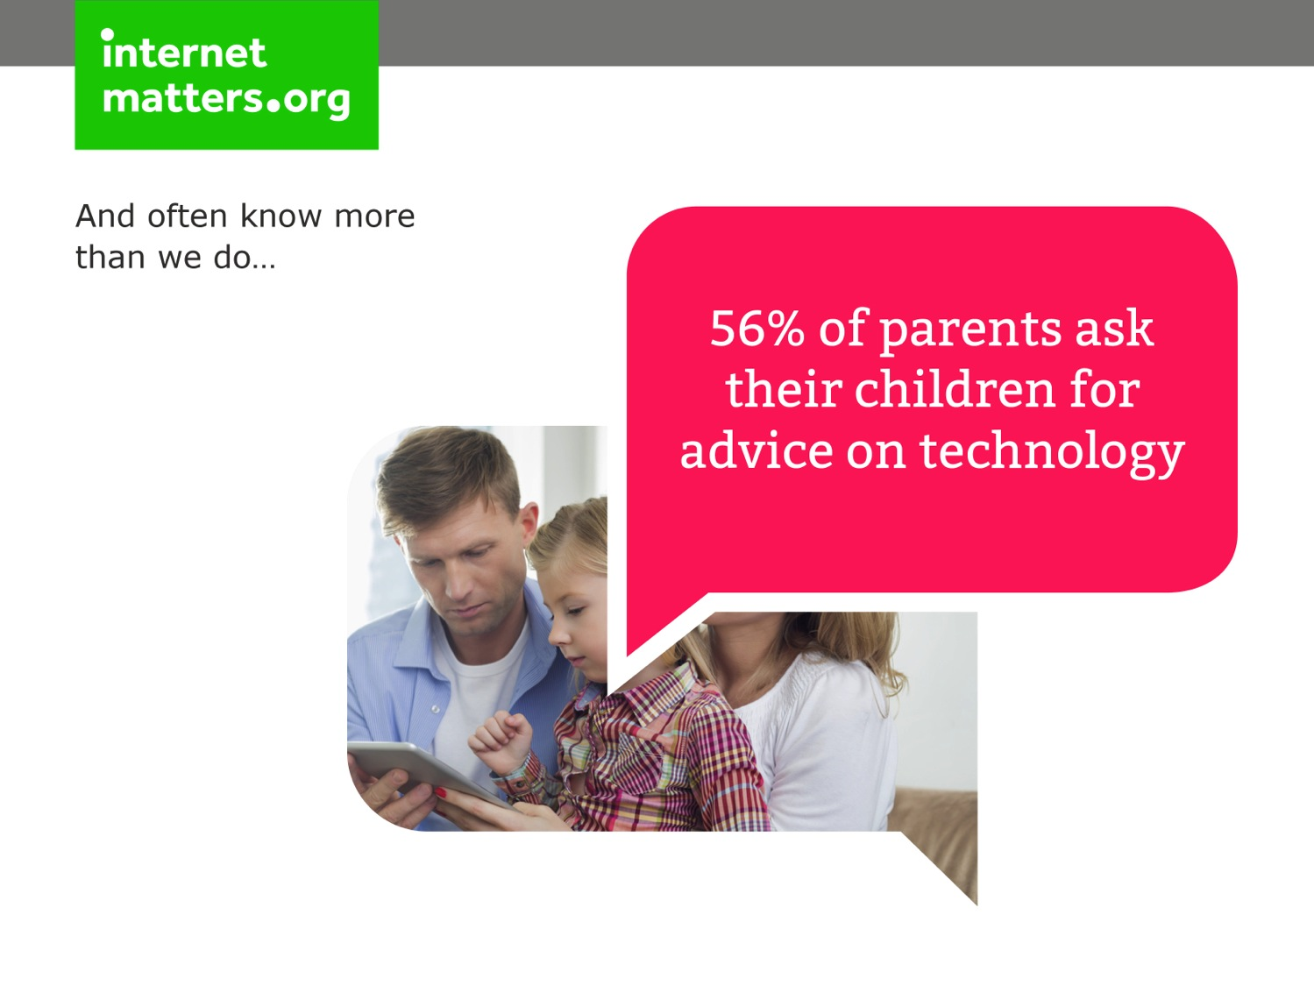

Slide 5


Slide 6
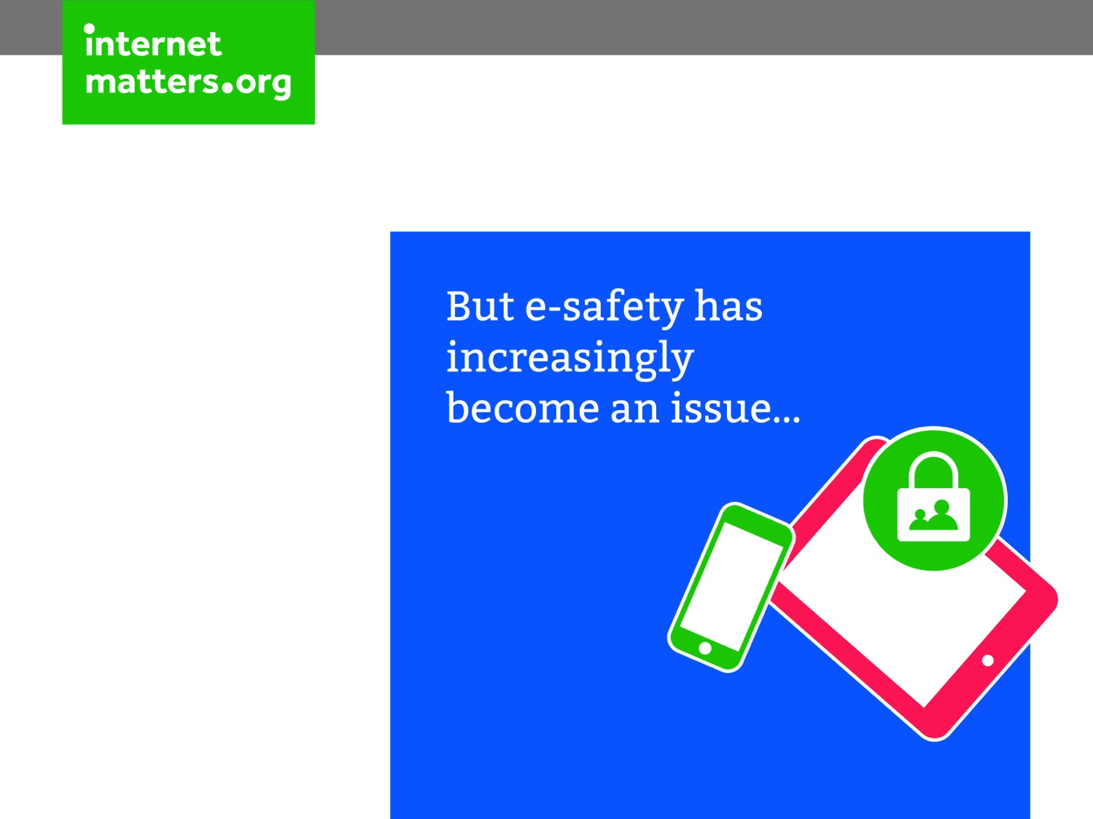

Slide 7
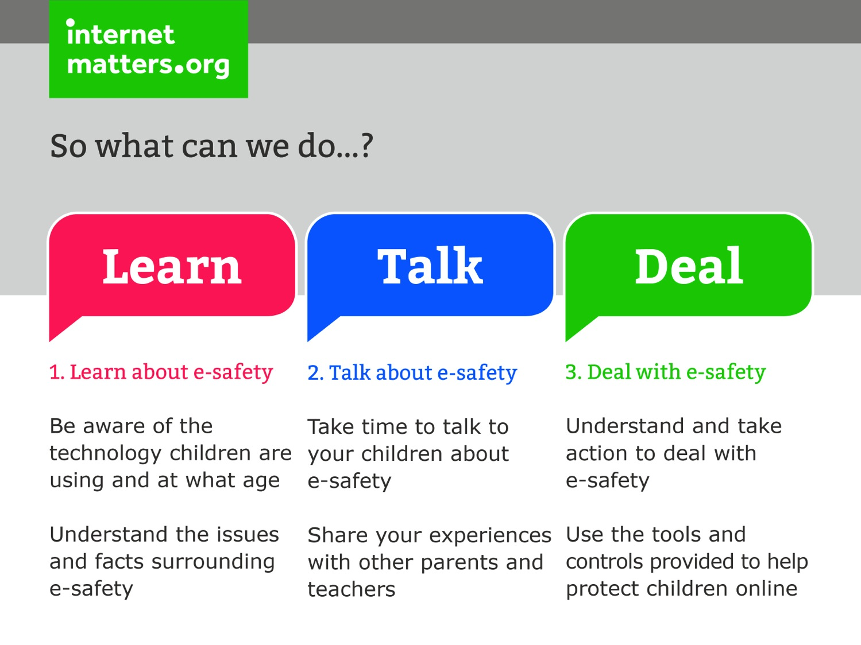

Slide 8
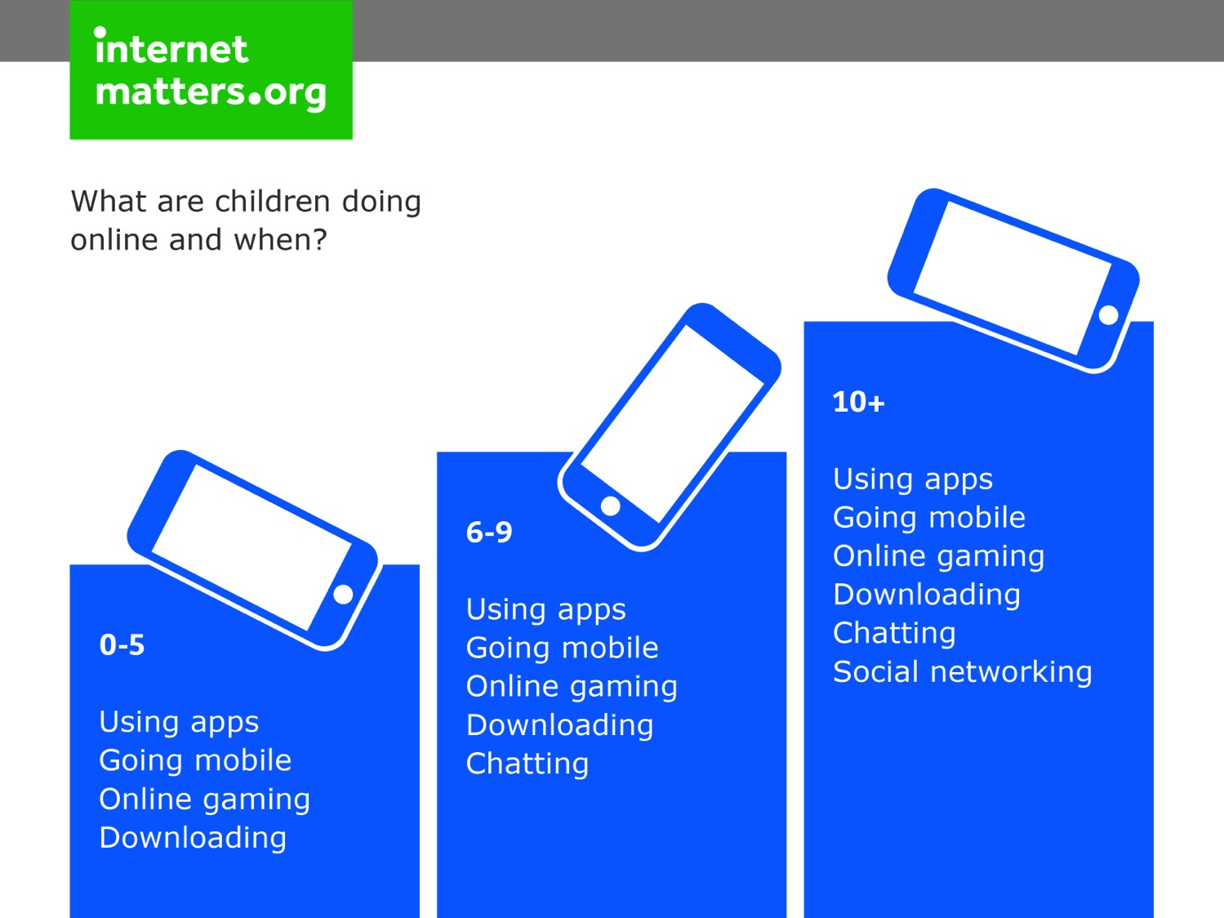

Slide 9

Notes:
Please note, slides 11-17 are optional if you feel you want to cover this age group as well

Slide 10
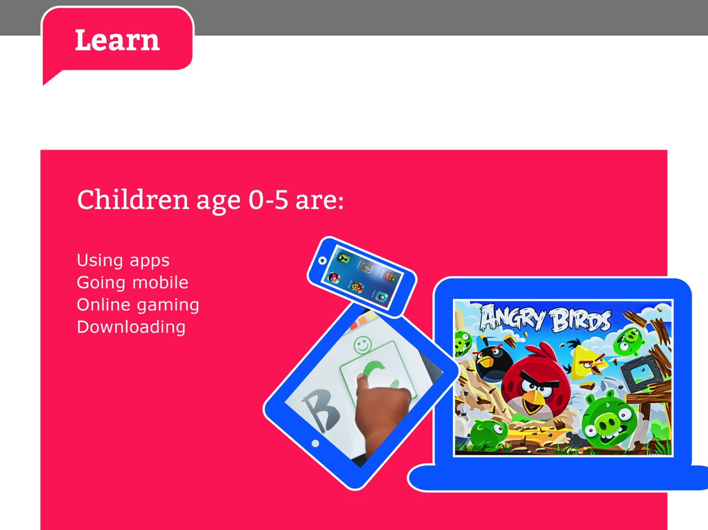
Notes:
Please note, slides 11-17 are optional if you feel you want to cover this age group as well

Slide 11
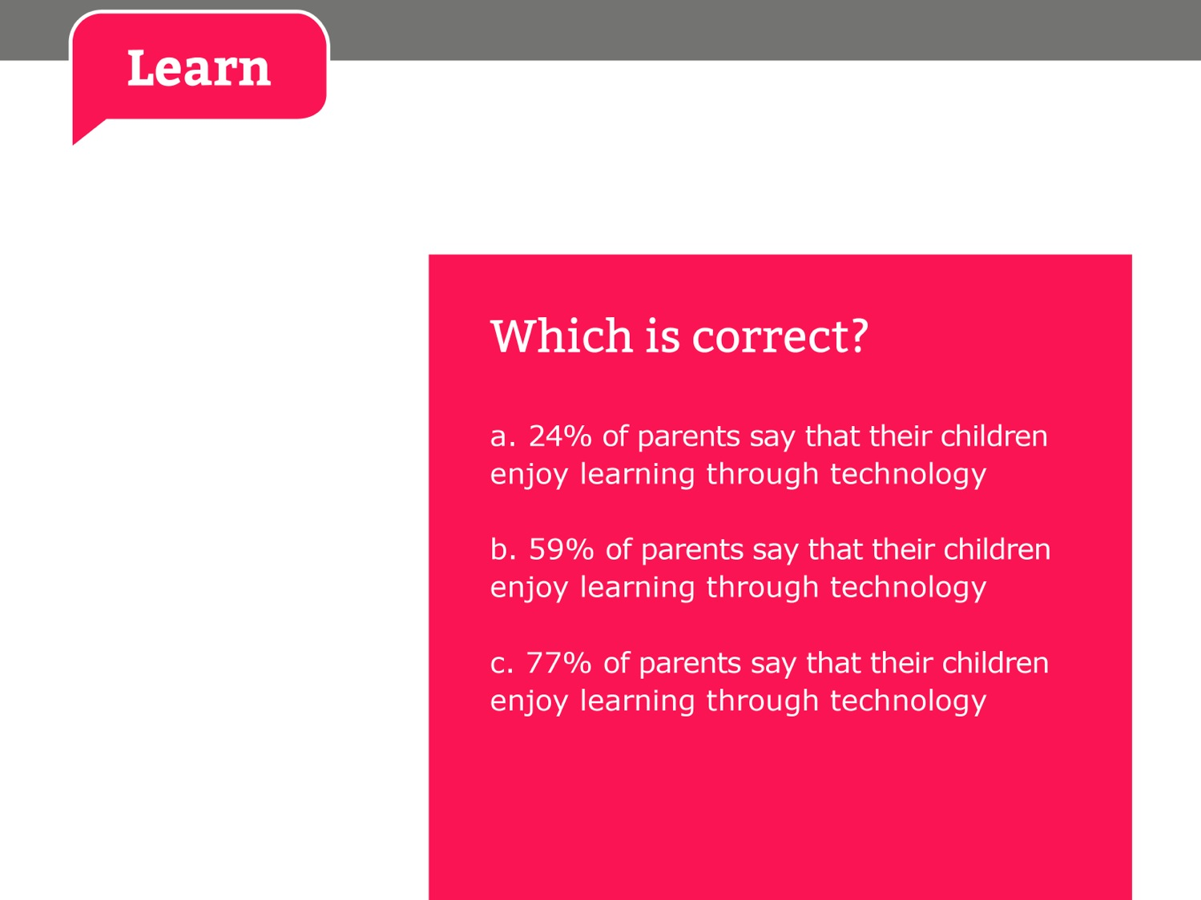
Notes:
Please note, slides 11-17 are optional if you feel you want to cover this age group as well

Slide 12
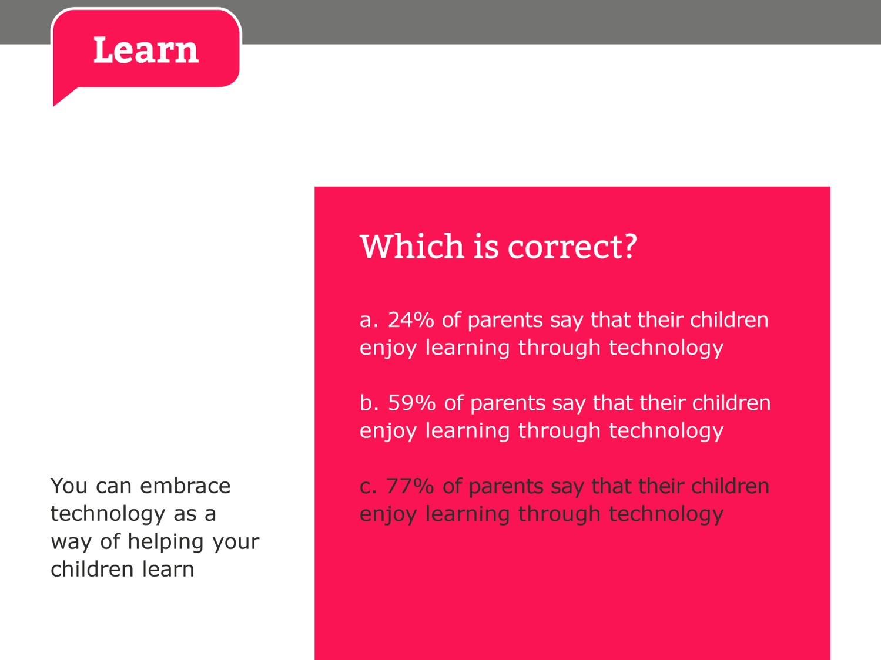
Notes:
Please note, slides 11-17 are optional if you feel you want to cover this age group as well

Slide 13
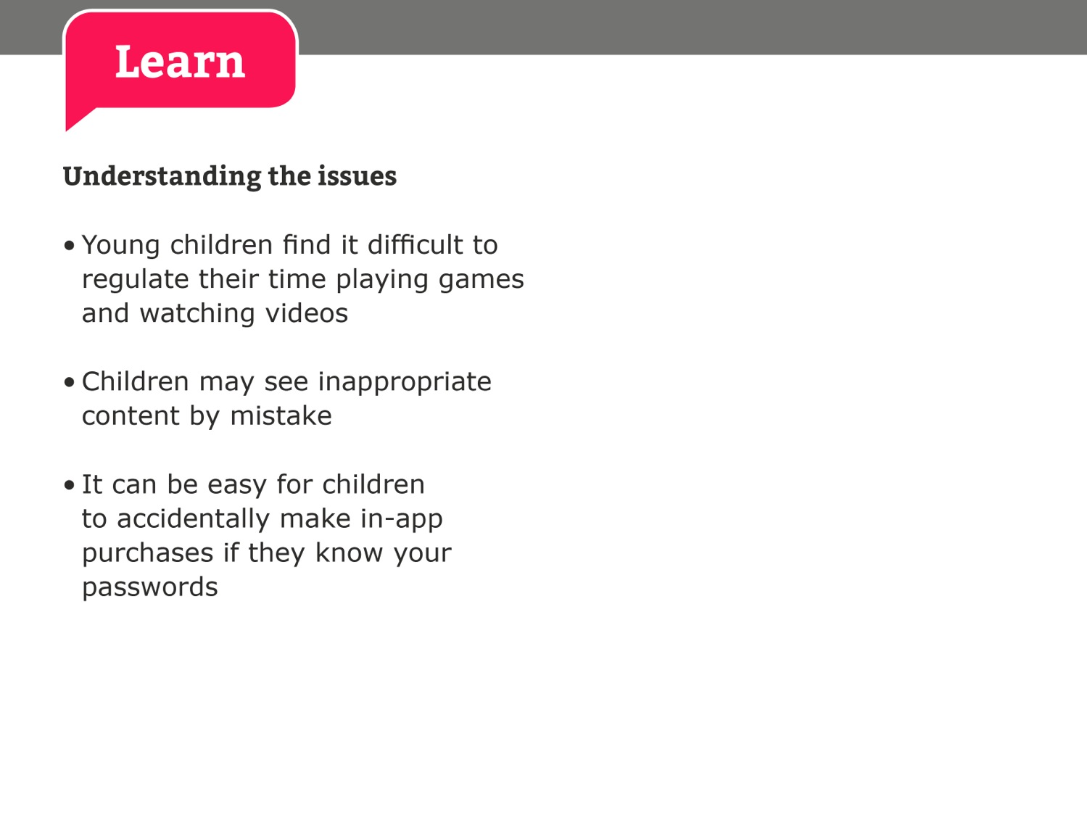
Notes:
Please note, slides 11-17 are optional if you feel you want to cover this age group as well

Slide 14
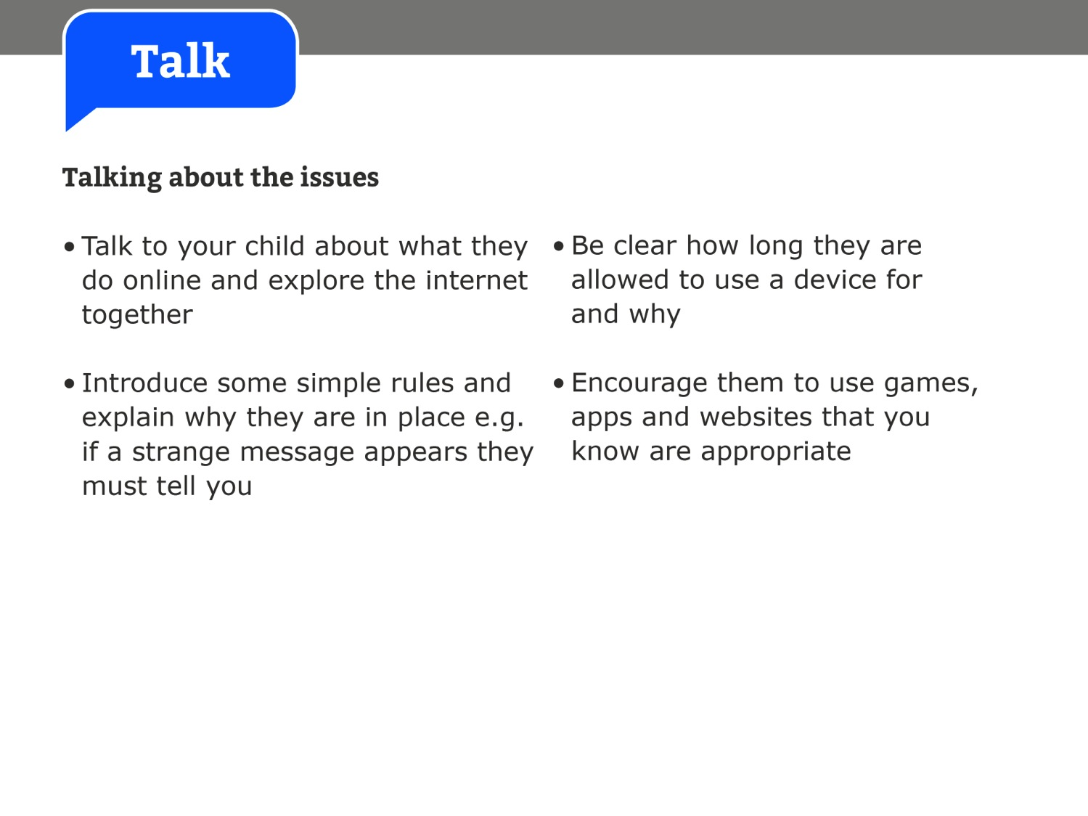
Notes:
Please note, slides 11-17 are optional if you feel you want to cover this age group as well

Slide 15
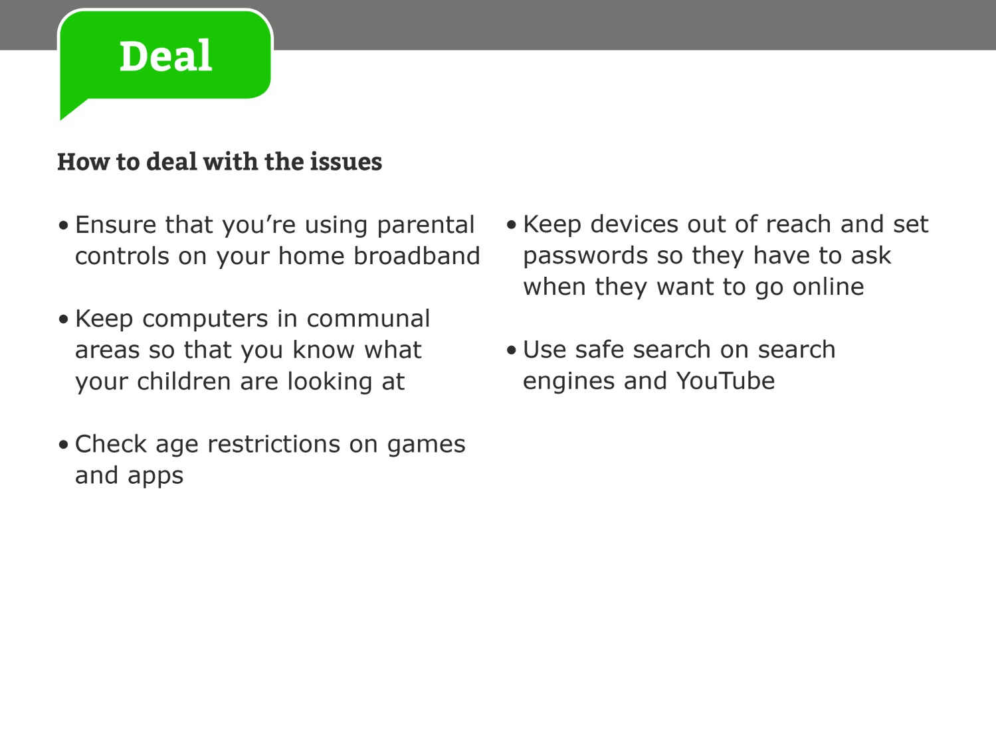
Notes:
Please note, slides 11-17 are optional if you feel you want to cover this age group as well

Slide 16


Slide 17
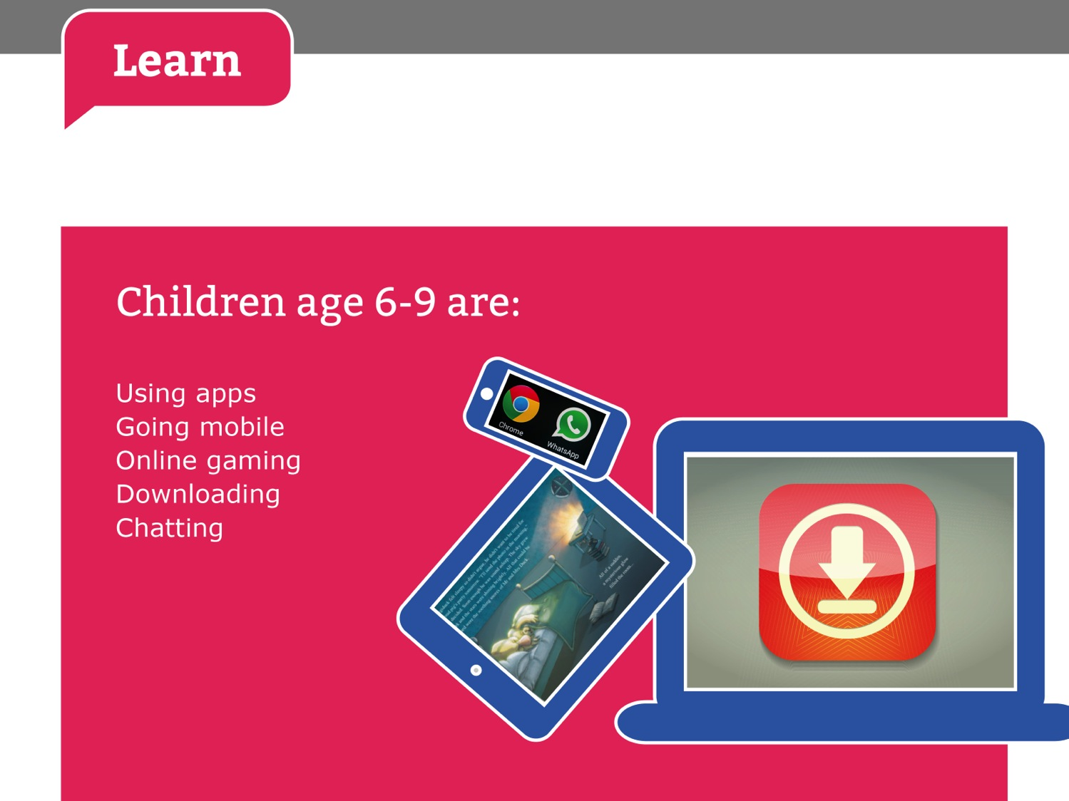

Slide 18


Slide 19
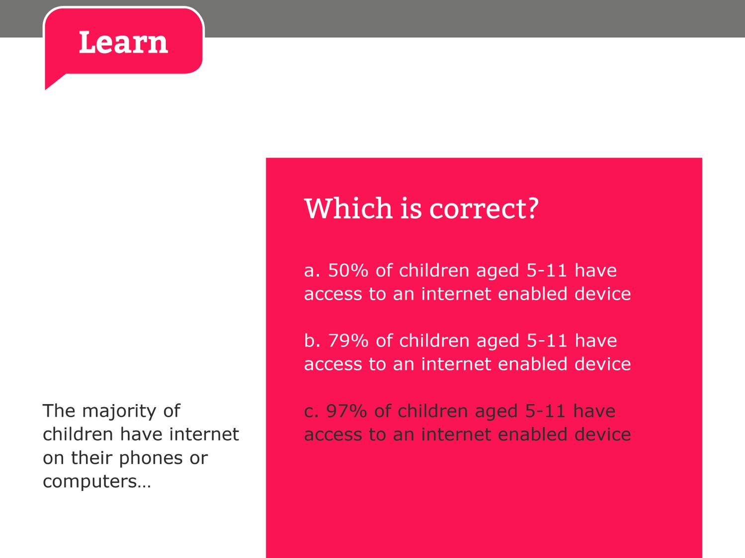

Slide 20
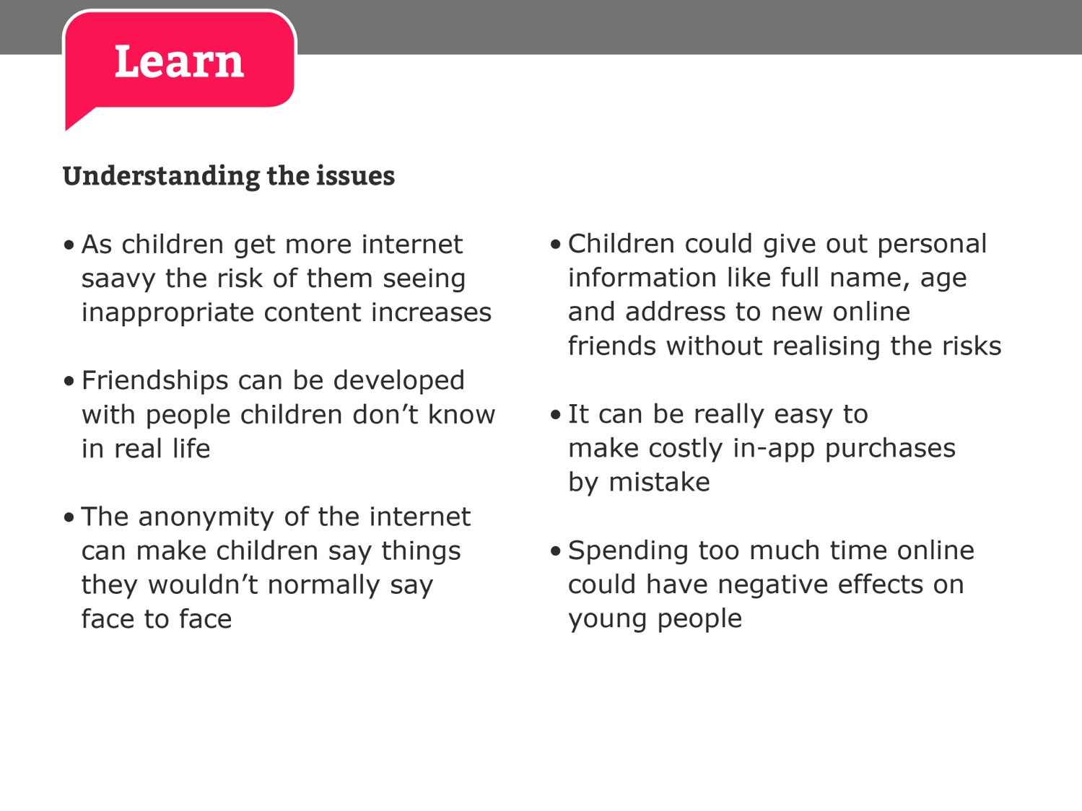

Slide 21
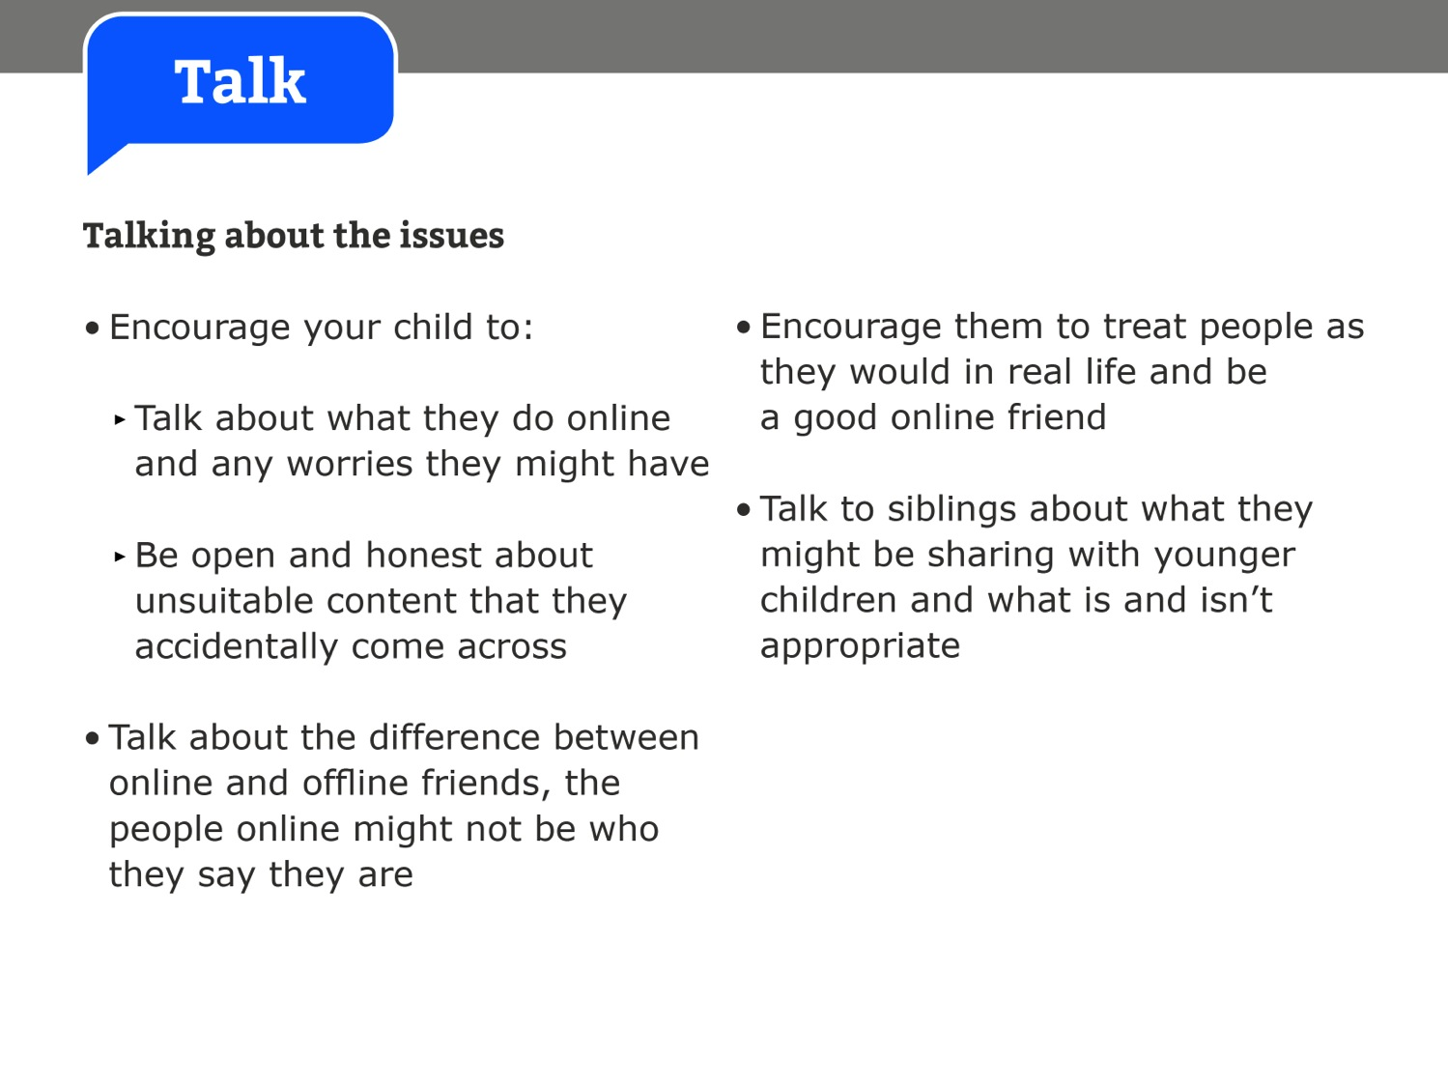

Slide 22
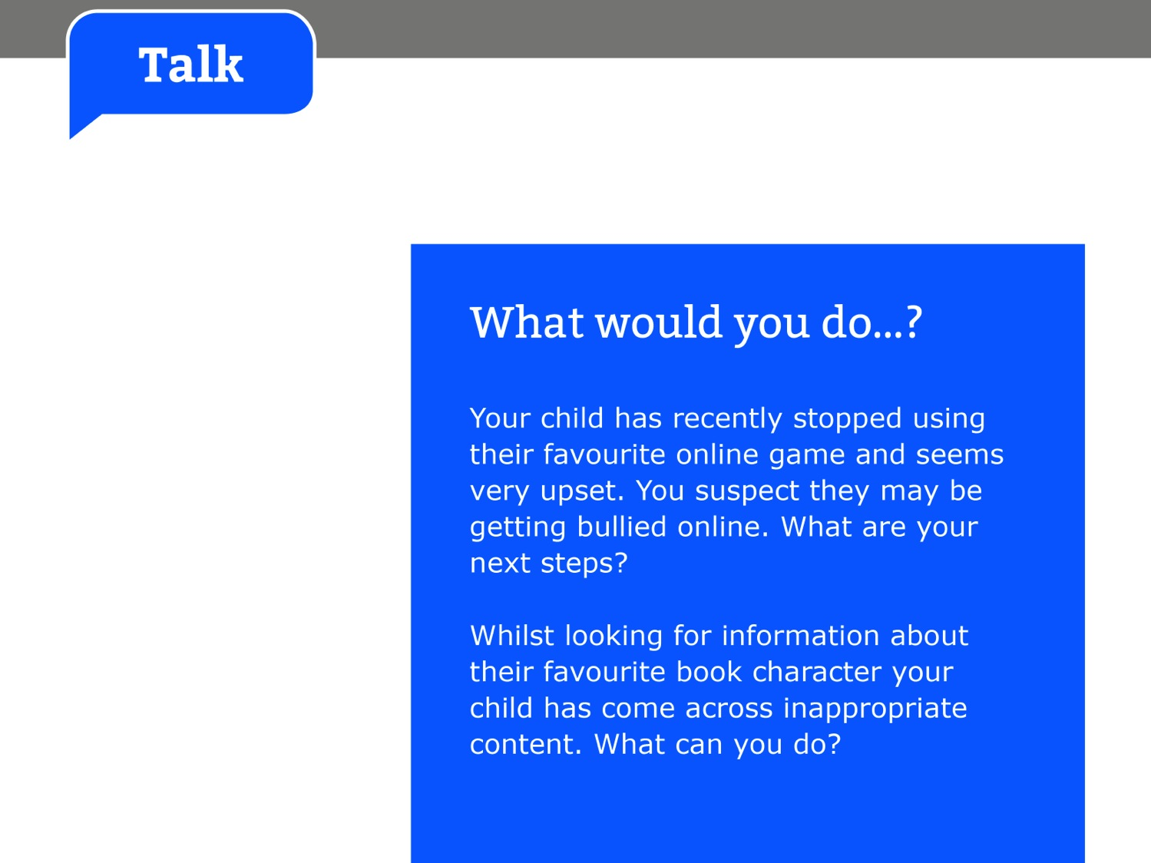

Slide 23
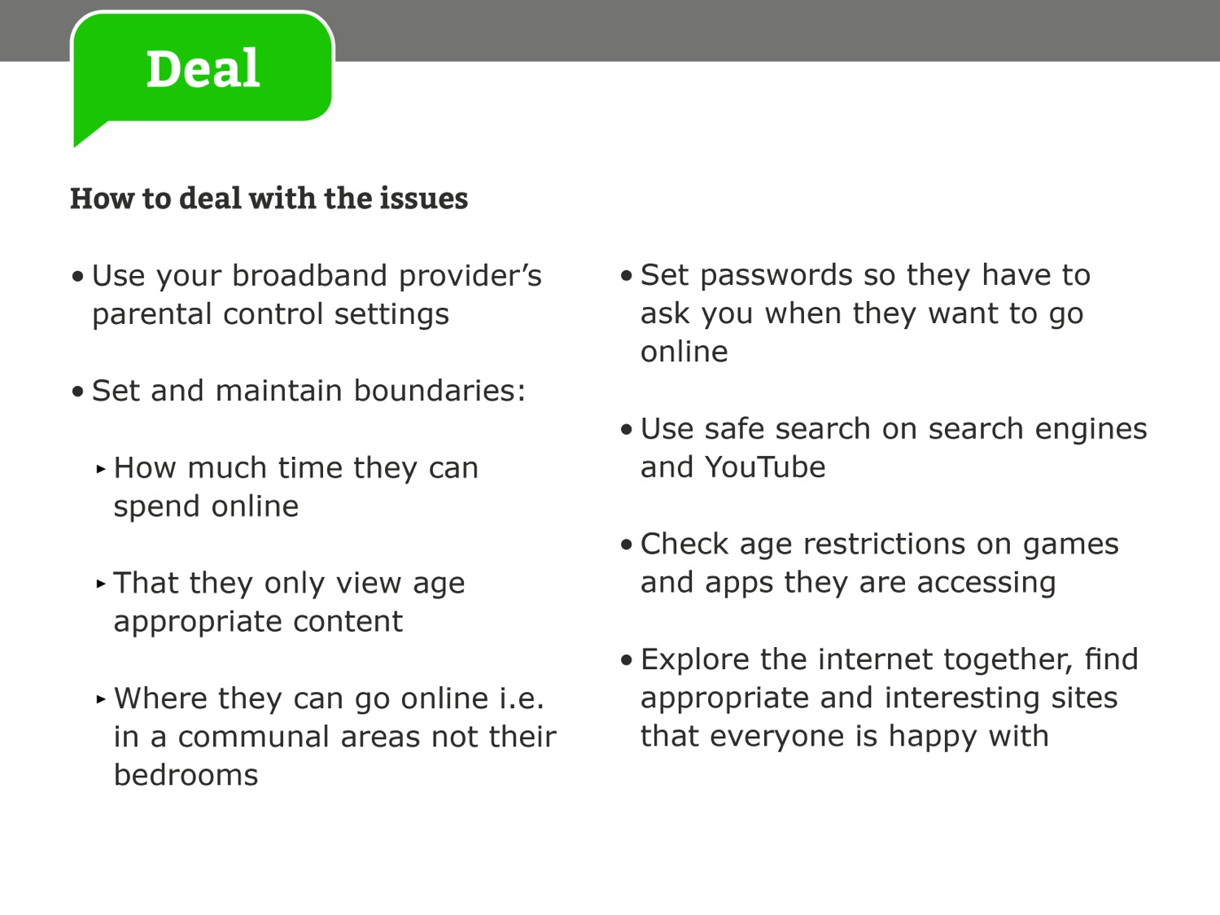

Slide 24


Slide 25
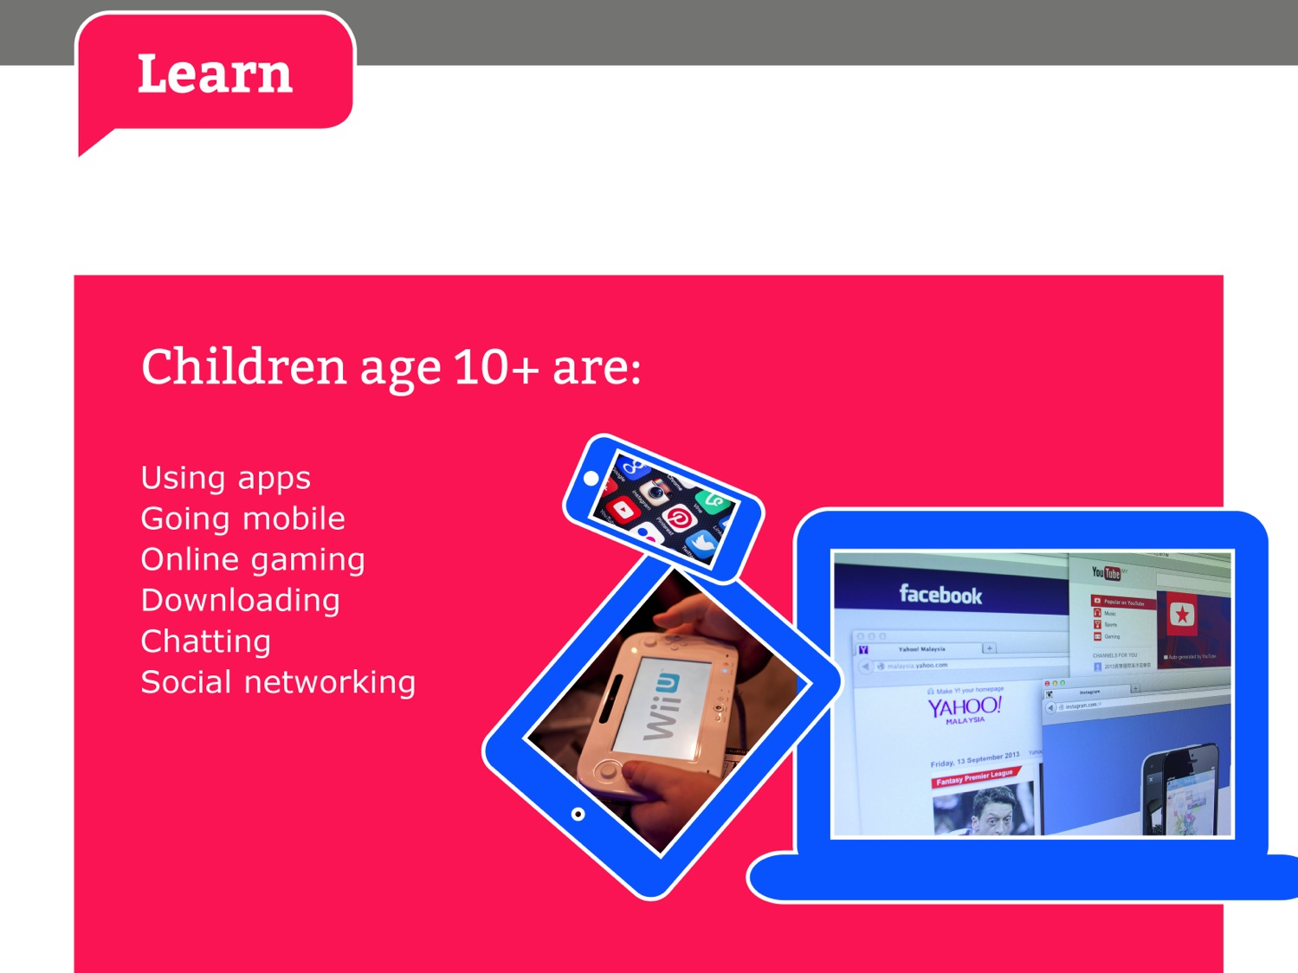

Slide 26
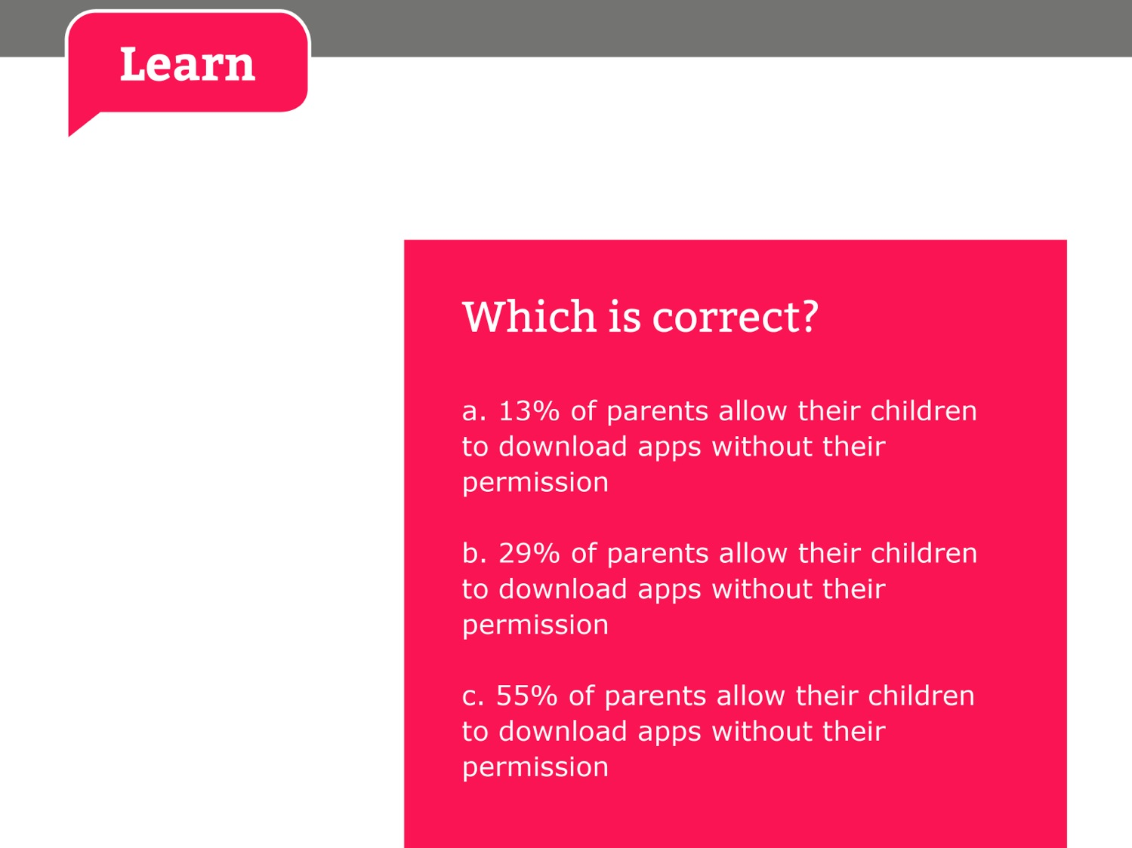

Slide 27
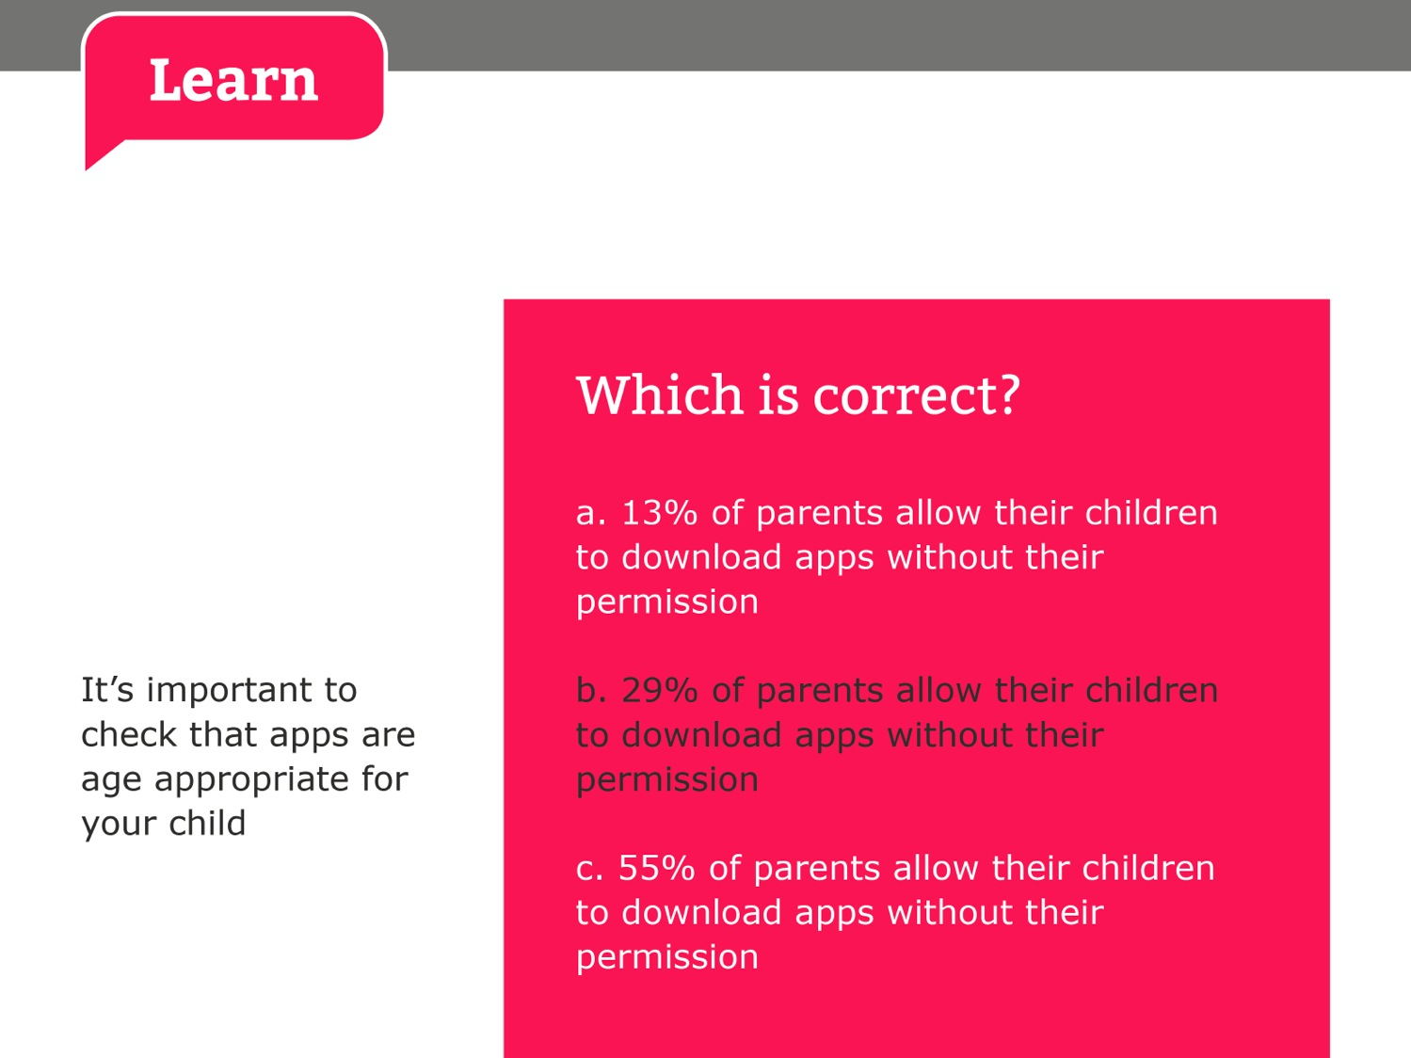

Slide 28
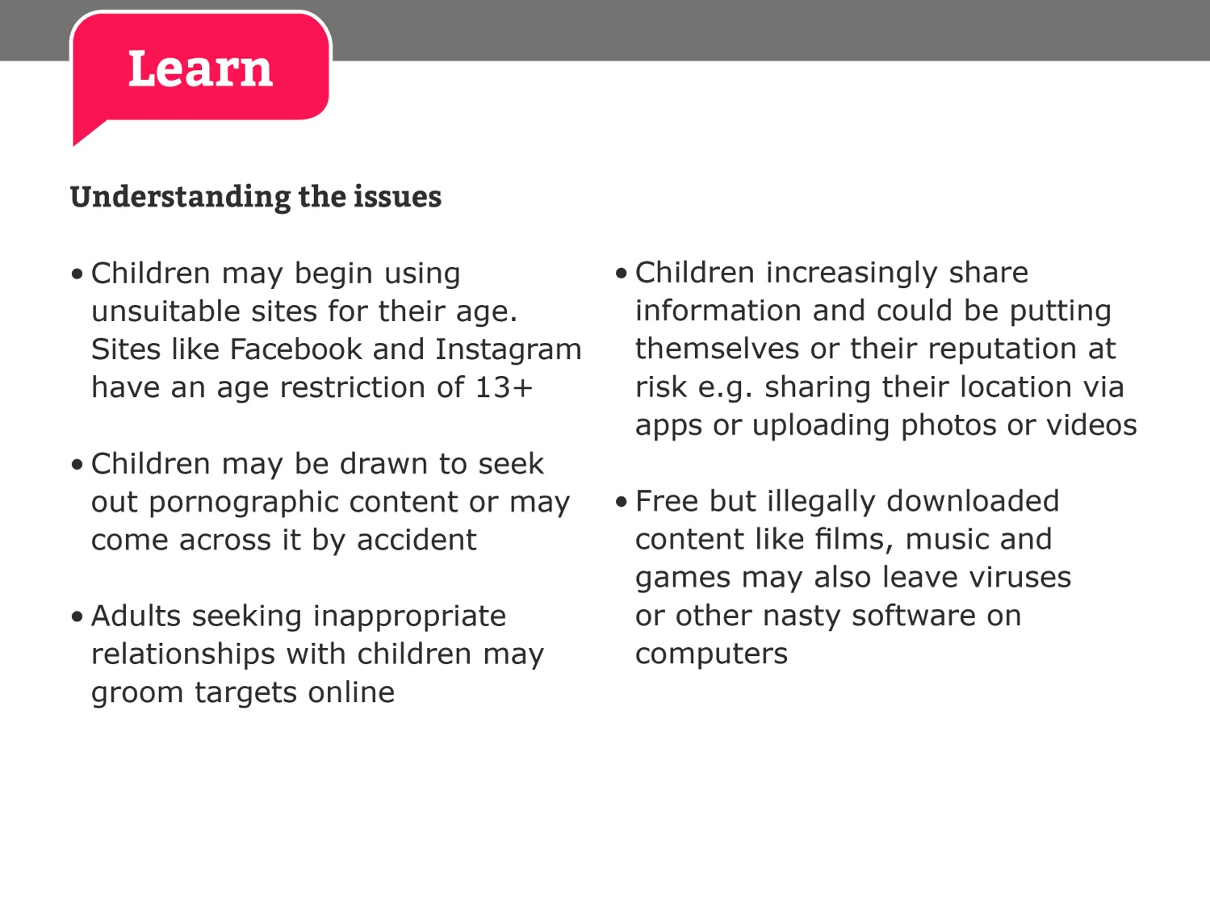

Slide 29
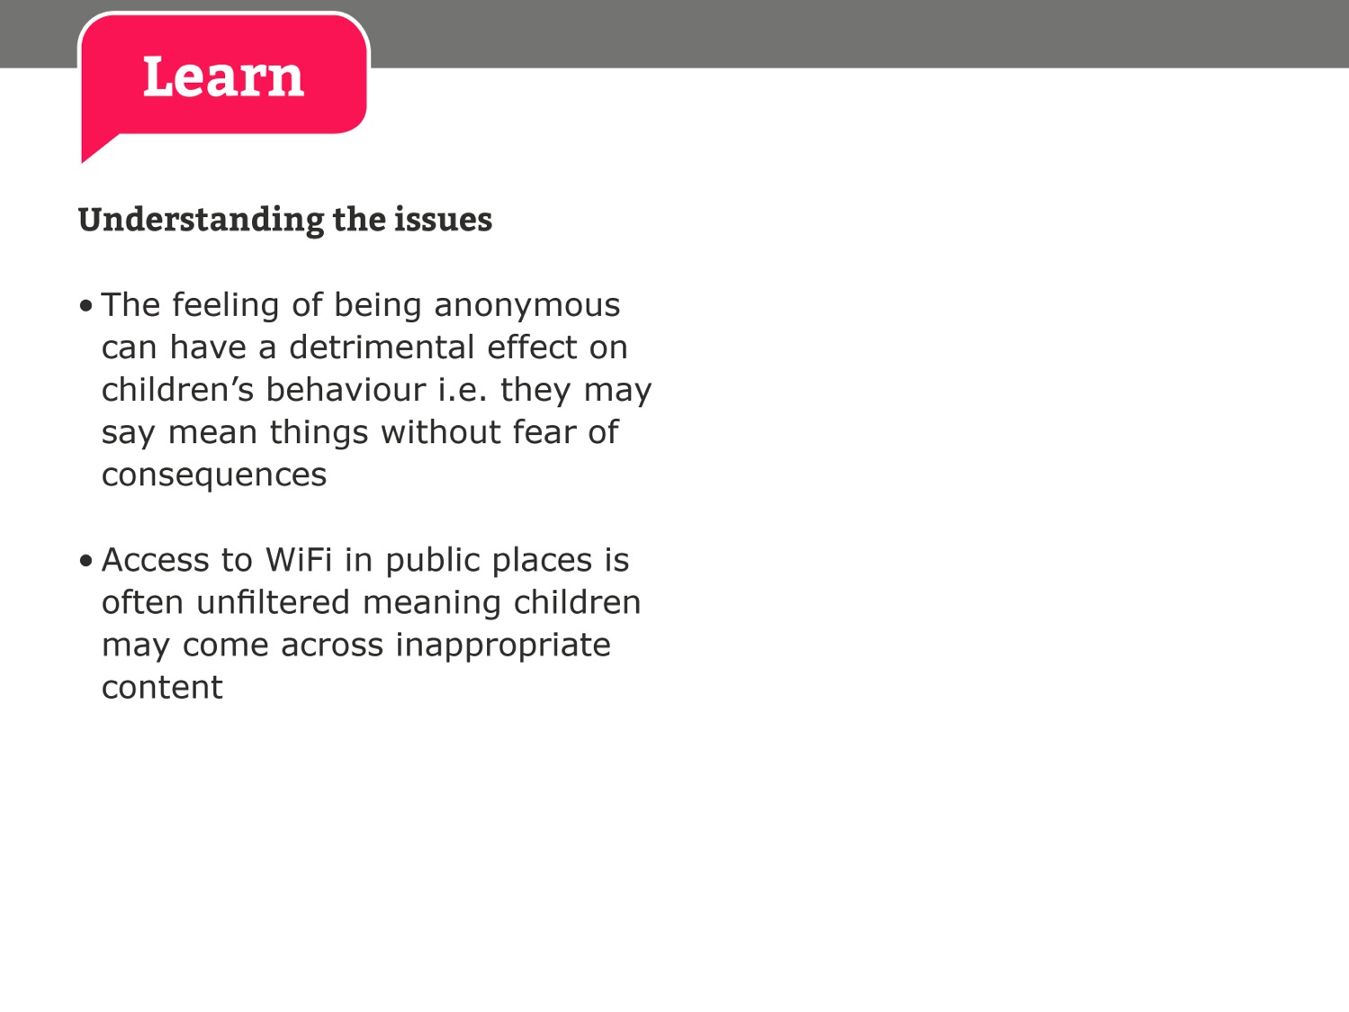

Slide 30
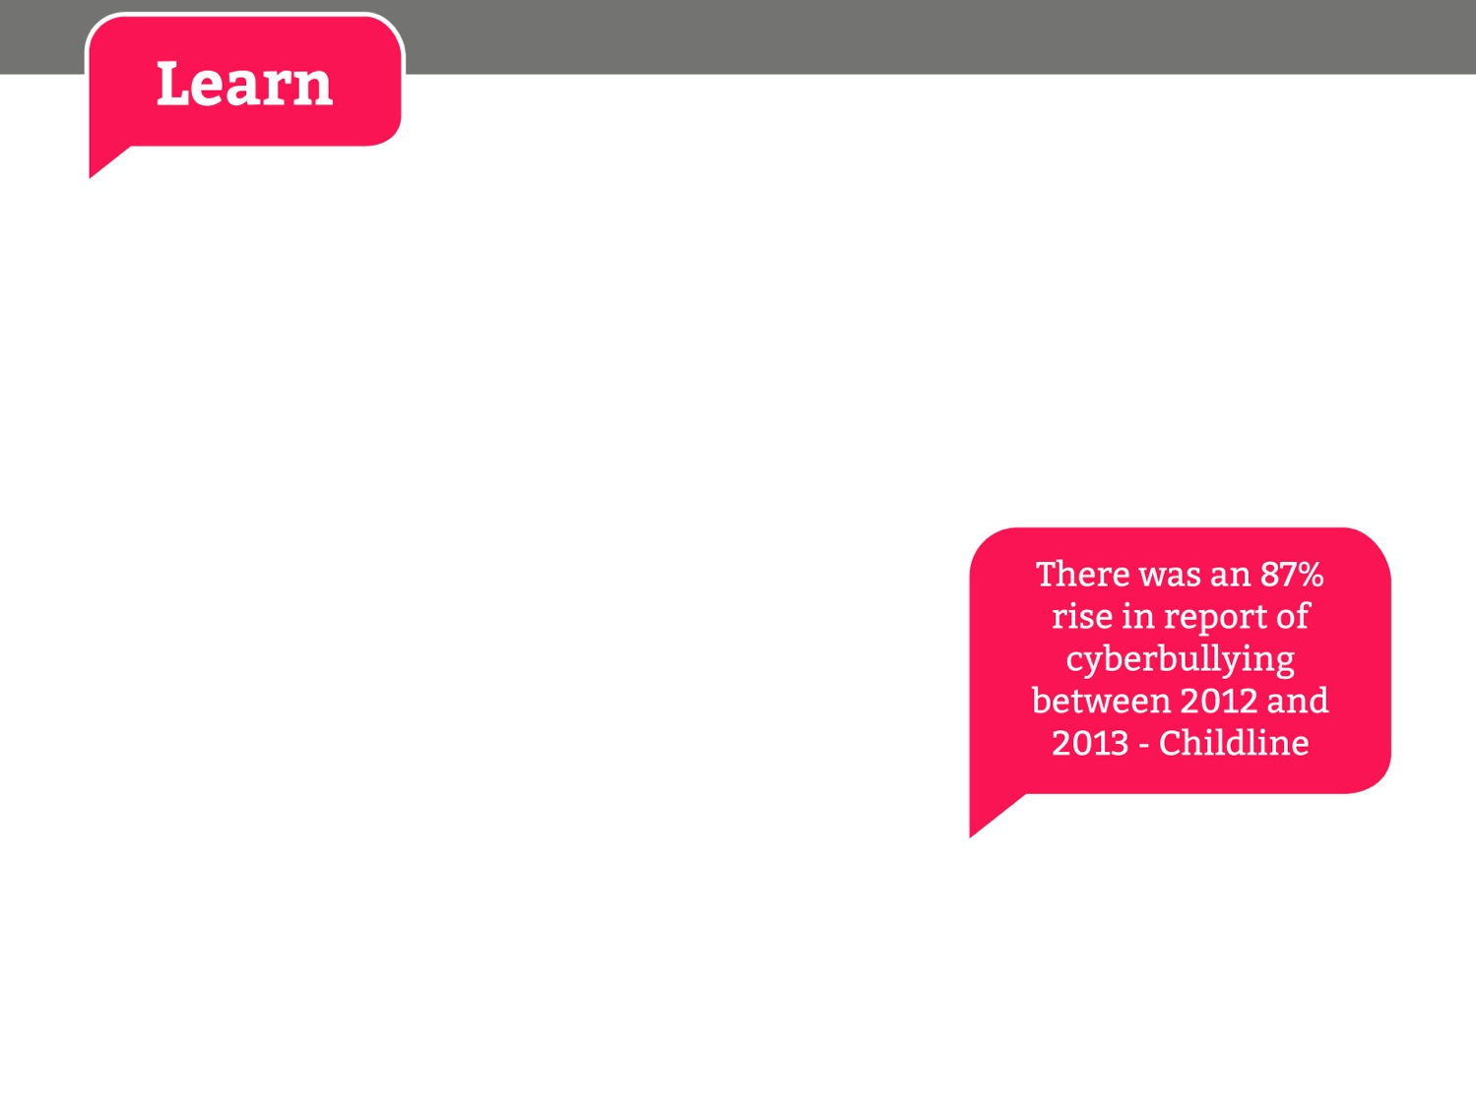
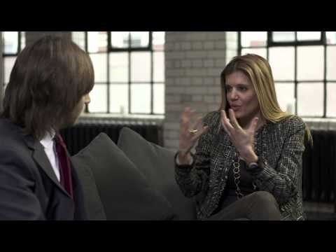
Click here to open hyperlink to video
Notes:
Risks children face online: Cyberbullying (Primary) - http://www.youtube.com/watch?v=5yVE0XszE3A
http://www.internetmatters.org/issues/cyberbullying.html

Slide 31
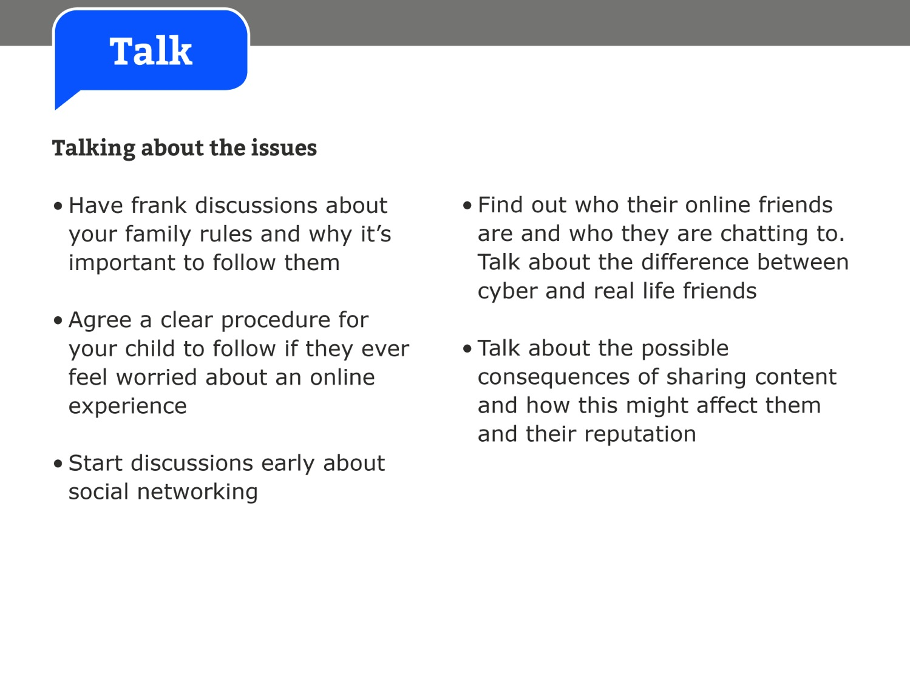

Slide 32


Slide 33
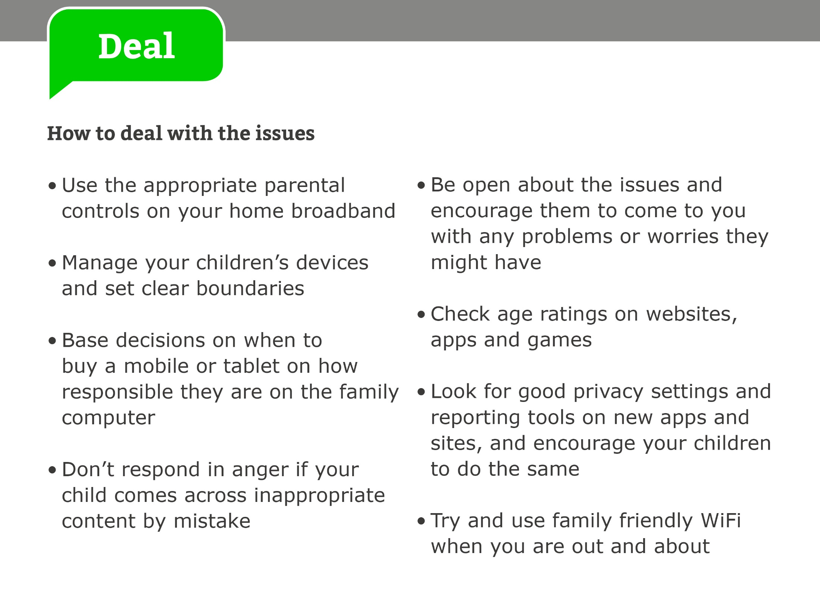

Slide 34
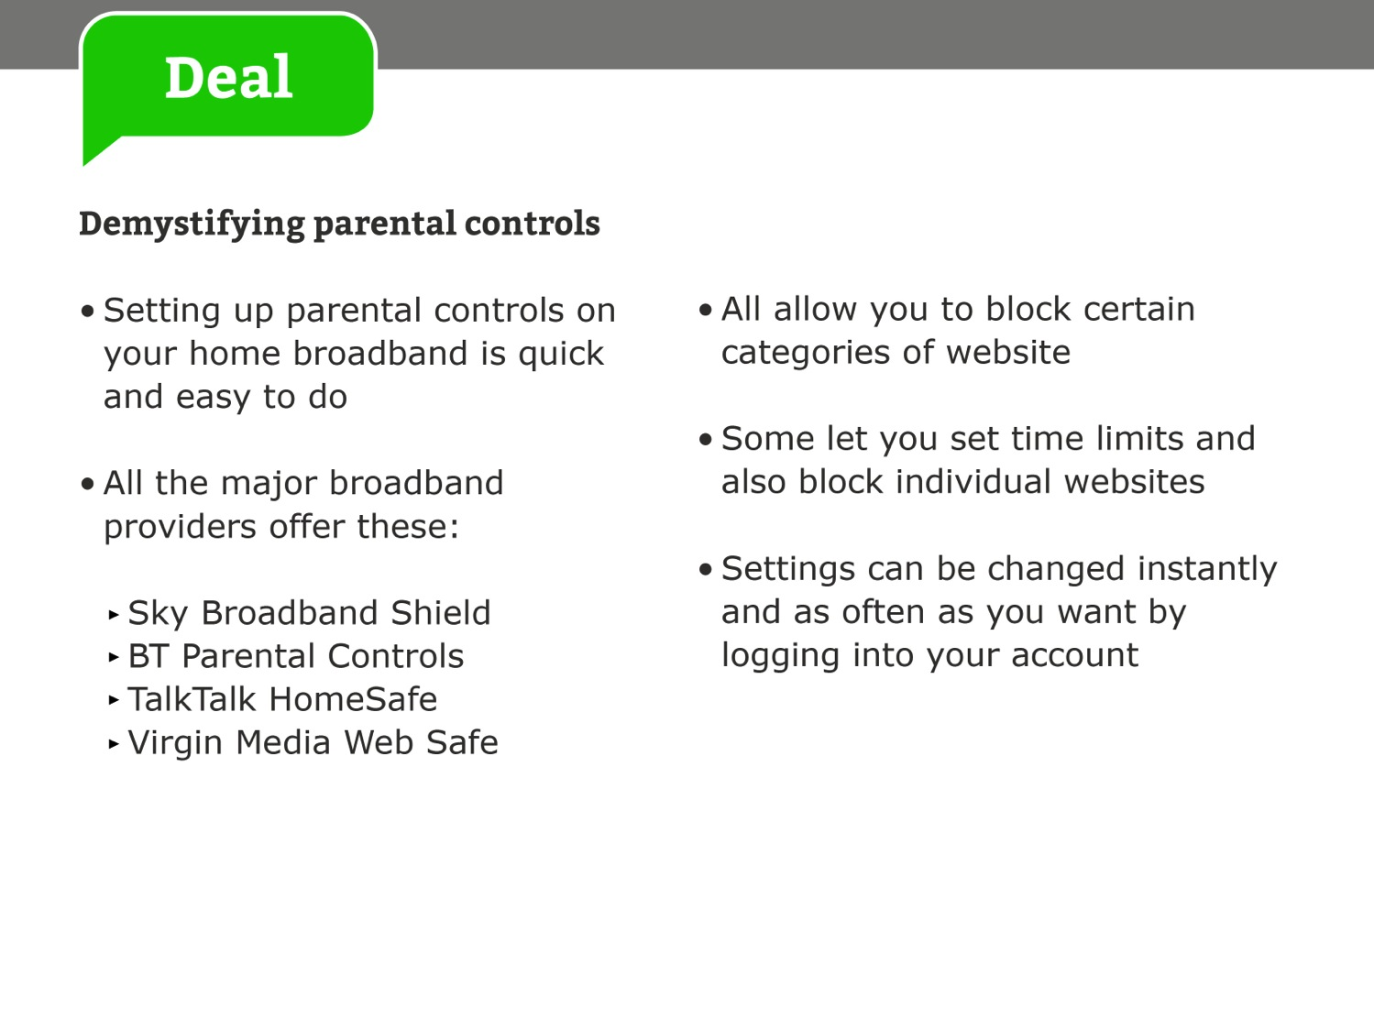

Slide 35
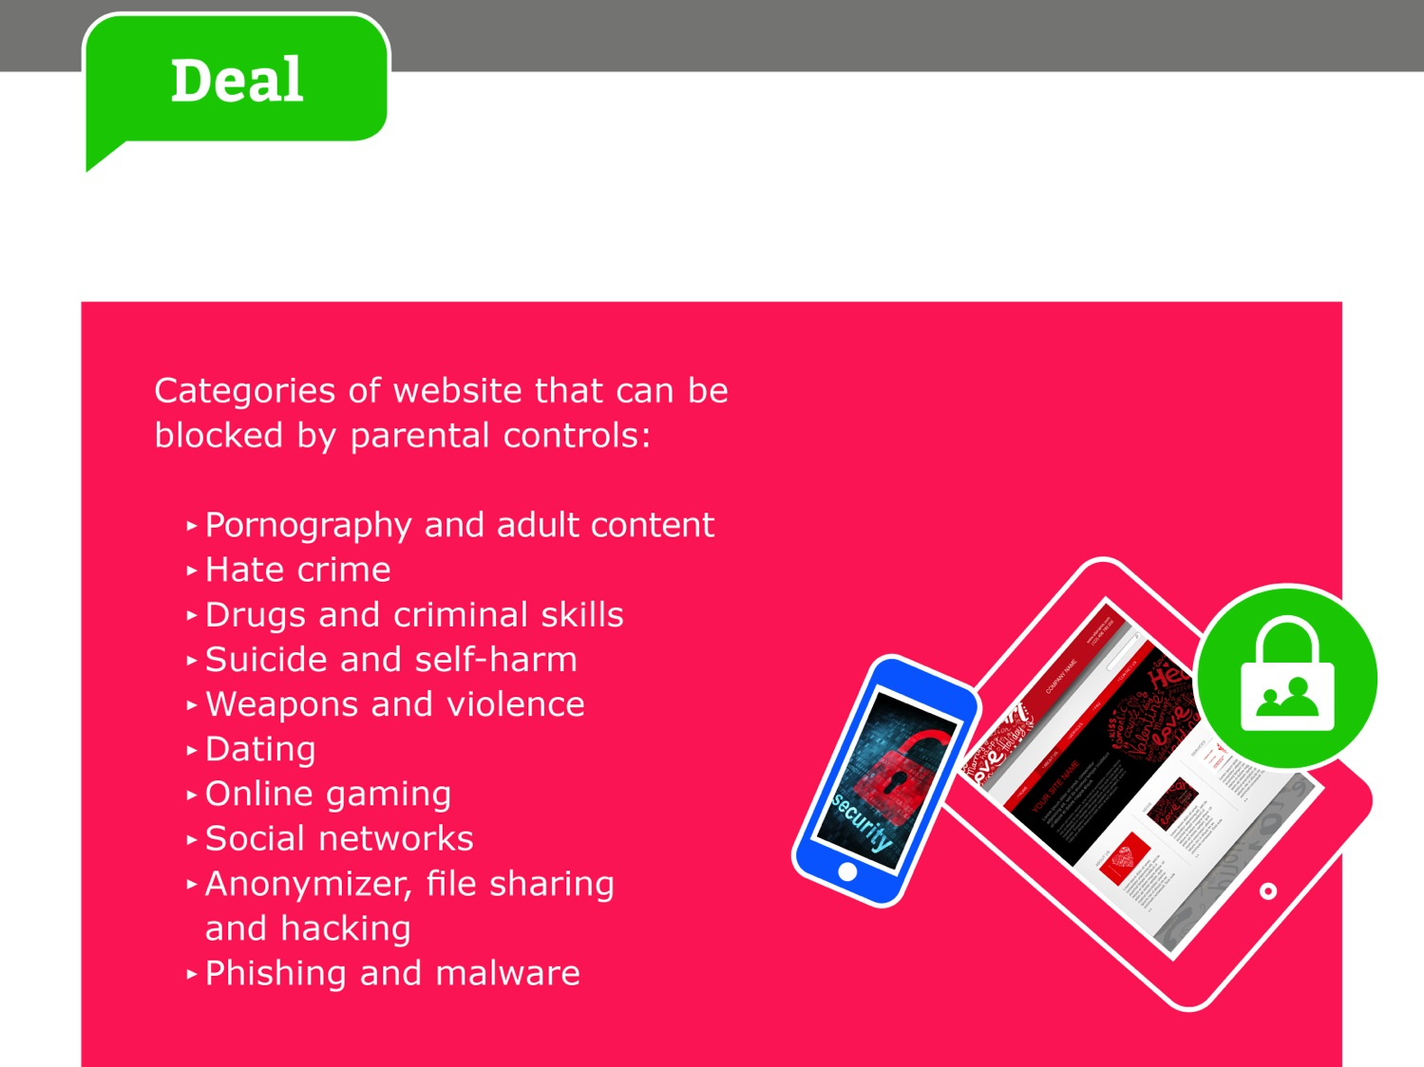
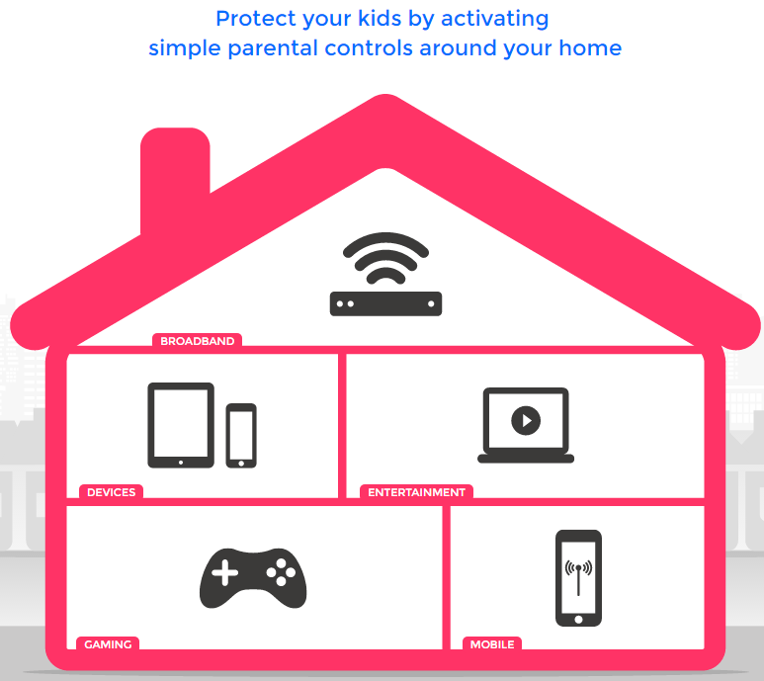
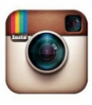

Slide 36


Slide 37


Slide 38
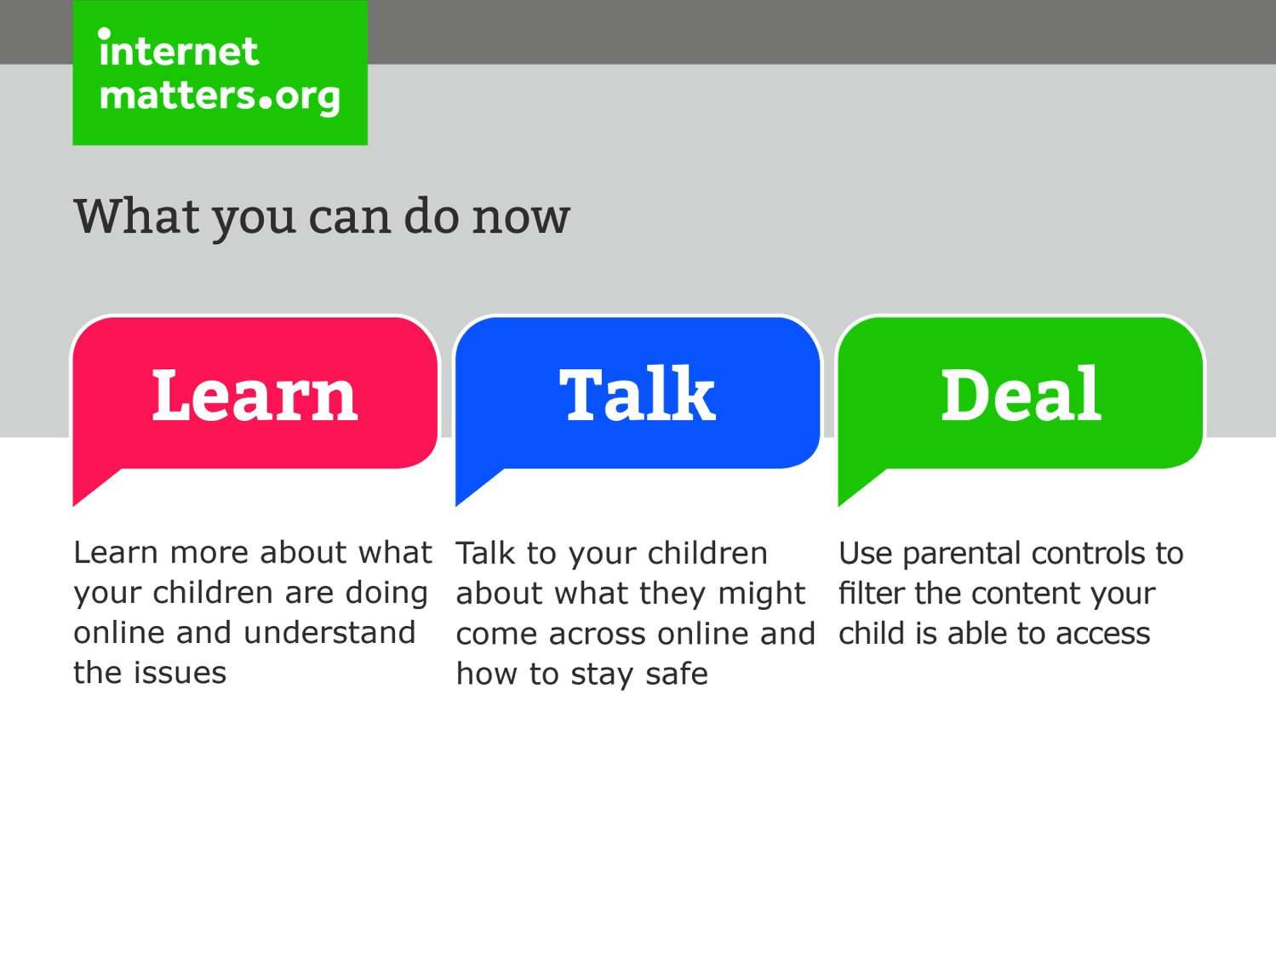

Slide 39


